Slide 1

HACK-AI-THON 2026 • NATIONAL LEVEL
AquaGuard
Community Water Quality & Usage Monitor
SDG 6 — Clean Water and Sanitation | SDG 12 — Responsible Consumption
Presented by
Team AquaGuard
Python Fundamentals • Object-Oriented Programming • Sustainable Development

Slide 2
Contents
01
Introduction
05
How It Works
Project overview & vision
Step-by-step workflow
02
Problem Statement
06
Demo & Results
What to build & expected output
Live GUI screenshot & report
03
Objectives
07
Key Features
Goals of AquaGuard
Alerts, trends & recommendations
04
System Design & OOP
08
Conclusion & Future Scope
Classes, architecture & logic
Impact and next steps

Slide 3
Introduction to AquaGuard
What is AquaGuard?
Python + OOP
Clean classes, encapsulation & modular design
AquaGuard is a Python-based water monitoring system designed for households, schools, and communities. It records daily water usage and basic water-quality observations (pH & turbidity) and automatically flags potentially unsafe or abnormal conditions.
Real-time Alerts
Flags high consumption, bad pH or turbidity
Why it matters
Clean water is essential for health (SDG 6)
Responsible consumption reduces waste (SDG 12)
Early detection of quality issues prevents illness
Data-driven insights promote conservation habits
Smart Reports
Trends, averages & conservation tips

Slide 4
Problem Statement
WHAT TO MAKE
Develop a Python-based water monitoring system for households, schools or communities. Record water usage and basic water-quality observations and flag potentially unsafe or abnormal conditions.
Minimum Functional Requirements
▸ Create Location/User, WaterReading and MonitoringReport classes
▸ Record parameters: daily consumption, pH and turbidity (sample data)
▸ Calculate consumption trends & identify abnormal readings via thresholds
▸ Generate alerts & recommendations for excessive use or unsafe values
▸ Produce location-wise / household-wise summaries

Slide 5
Objectives & Expected Output
EXPECTED OUTPUT
PROJECT OBJECTIVES
A complete water-monitoring report containing:
Monitor Usage
Track daily water consumption per location
● Daily & average consumption
Quality Checks
● Quality status (Normal / Attention)
Detect unsafe pH & turbidity levels
Smart Alerts
● List of alerts with dates
Notify when thresholds are breached
● Consumption trend analysis
Trend Insights
Show increasing / decreasing / stable usage
● Recommended conservation actions
Actionable Tips
Recommend conservation & safety steps

Slide 6
System Design — OOP Classes
Location
User
Attributes
Attributes
name, address, location_type
user_id, name, role
Key Methods
Key Methods
__str__()
__str__()
WaterReading
MonitoringReport
Attributes
Attributes
date, location, user, consumption, pH, turbidity
report_id, generated_by, location, readings
Key Methods
Key Methods
is_abnormal(), get_alerts()
avg_consumption(), trend(), status(), recommendations()

Slide 7
How AquaGuard Works — Step by Step
1
2
3
Input Reading
Create Objects
Validate & Flag
User enters location, address, name, date, consumption (L), pH and turbidity values in the GUI form.
System instantiates Location, User and WaterReading objects and stores them in memory.
is_abnormal() checks against thresholds (pH 6.5–8.5, turbidity ≤5 NTU, consumption ≤450 L).
4
5
6
Display List
Generate Report
Show Insights
All readings appear sorted by date with Normal / Abnormal status indicators.
MonitoringReport calculates averages, trend, collects alerts and builds recommendations.
Full formatted report with status, alerts and conservation tips is displayed to the user.

Slide 8
Alert Thresholds & Recommendation Logic
pH
Turbidity
Consumption
6.5 – 8.5
≤ 5.0 NTU
≤ 450 L/day
Outside range → Alert
Above limit → Filter / Boil
Above limit → Check leaks
CONSUMPTION TREND LOGIC
Increasing ⬆ Last reading > first reading × 1.15
Decreasing ⬇ Last reading < first reading × 0.85
Stable → Otherwise (within ±15%)

Slide 9
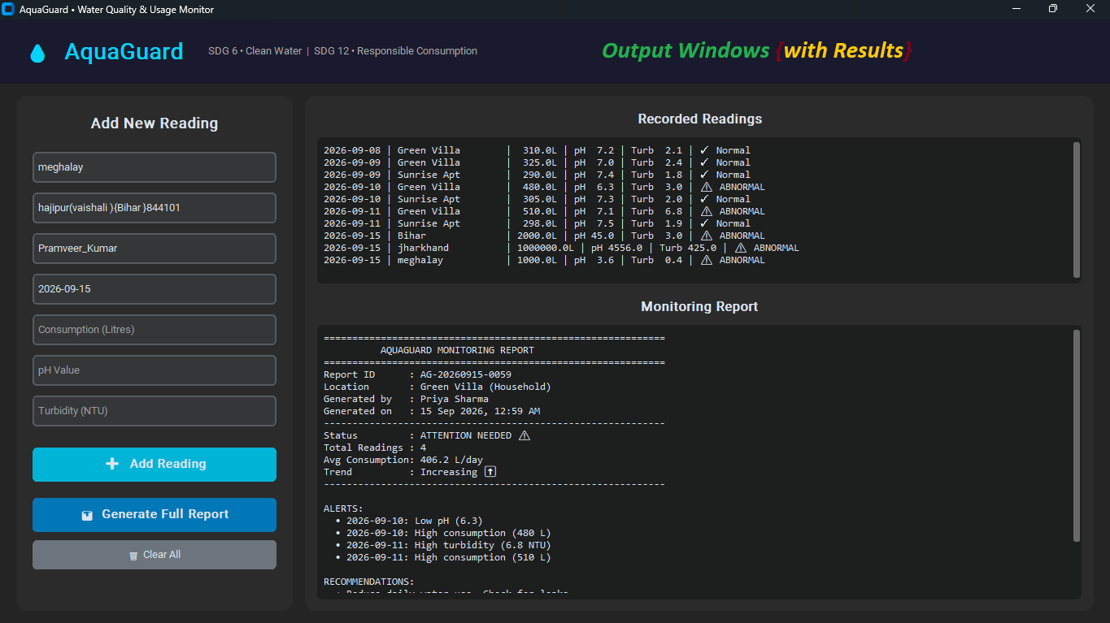
Live Demo — GUI & Results

Slide 10
Key Features & Implementation Highlights
💧 Modern Dark GUI
📊 Instant Status
📈 Trend Analysis
Built with CustomTkinter – clean, responsive and user-friendly interface matching the AquaGuard brand.
Every reading is labelled Normal or Abnormal instantly using threshold-based logic.
Compares first vs last reading to detect Increasing, Decreasing or Stable consumption patterns.
🚨 Smart Alerts
💡 Actionable Tips
🏠 Multi-Location
Aggregates all abnormal events with dates and clear reasons (Low/High pH, High turbidity, High use).
Context-aware recommendations: leak checks, filtration, boiling water, conservation advice.
Supports multiple households / schools; reports can be generated per location.

Slide 11
Conclusion
AquaGuard successfully demonstrates Python fundamentals and Object-Oriented Programming while delivering a practical solution aligned with SDG 6 and SDG 12.
Functional Prototype
Fully working GUI that records readings, detects anomalies and produces professional reports.
Clean OOP Design
Four well-defined classes with clear responsibilities, encapsulation and reusable methods.
Real Impact Potential
Helps communities track water use, improve quality awareness and adopt conservation habits.
Extensible Foundation
Ready for future sensors, databases, mobile apps and multi-user dashboards.

Slide 12
Future Scope & Next Steps
→ Integrate IoT sensors for automatic real-time readings
→ Store data in SQLite / cloud database for historical analysis
→ Add multi-user login and role-based access (Admin / Resident)
→ Generate PDF / Excel export of monitoring reports
→ Mobile companion app for on-the-go alerts
→ Machine-learning models to predict future consumption patterns
Thank You!
Questions? | AquaGuard • HACK-AI-THON 2026

